Slide 1
Three steps to change: Lessons from Bureaucracy
Paula Thrasher
@paula_thrasher

Slide 2

20+ years in IT
Agile in Federal Government since 2001
15+ Federal Agencies/Components
Former Software Developer, IT Director
Paula Thrasher
Application Delivery Lead
CSC
@paula_thrasher

Slide 3
The Challenge: Fix this program
Can’t change money
Can’t change the contract
Can’t change people
Notes:
Can’t really use Fear - but that is ok, because fear is not a good way to change anyway

Slide 4

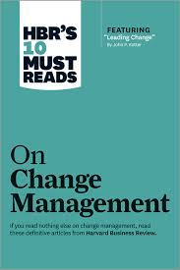
John Kotter 8-Steps to change
Establish a Sense of Urgency
Create a Guiding Coalition
Create a vision for change
Communicate the vision to gain buy-in
Empower broad based change
Generate short-term wins
Never let up
Incorporate changes into the culture
Notes:
So. this is the change bible. Dr Kotter studied companies in the 70s and 80s and learned that 70% of change initiatives fail. So he created this 8-step change guide, which you may have heard of before…
Look to your left, look to your right. Ok.
Statistically, two of you are going to fail and only one of you will succeed. I will let you all work out who is who at the break.

Slide 5
Paula’s Three-Step Formula
Establish a Sense of Urgency
Create a Guiding Coalition
Create a vision for change
Communicate the vision to gain buy-in
Empower broad based change
Generate short-term wins
Never let up
Incorporate changes into the culture
Want to Change
Know What to Change
Make the Change
Awesome side effect of letting teams fix themselves
Notes:
So with apologies to Dr. Kotter,
8 is too many
Especially for executives.
So here is my simplified three things to succeed at change

Slide 6
Step 1:
Want to change

Slide 7
Have a Crisis
Notes:
Have a crisis is easy - Right, Rahm Emanual never waste a crisis! You don’t always get the crisis you want.
What was apparently left out of the Harvard Business Review guide is that sometimes, you can just “let the crisis happen”.

Slide 8
Make a Crisis
Notes:
You don’t always get the crisis you want however. So you can sometimes make one!

Slide 9
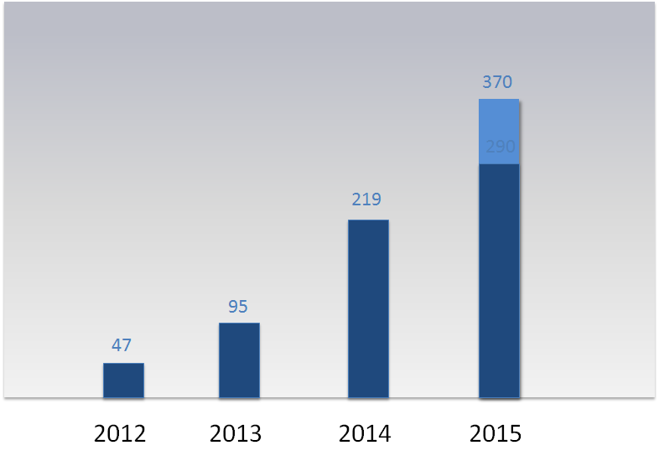
Deployments over time
Sucks to be the Operations Team!
Awesome to be a developer!
Notes:
It turns out that it is easier to make crisis than you think!!!
Sometimes you just have to to turn up the heat to make an organization aware it has to change.

Slide 10
Let a Crisis Happen
Notes:
Sometimes you need to stop saving something and let it fall on the floor.
Story: Spot the Station
Now…. onto step two…

Slide 11
Step 2:
Know what to change
Notes:
Step Two, now that you want to change
Know WHAT to change

Slide 12
Ways to make people know what to change
Visualize the work
Measure the work
Find the big picture
Notes:
Visualizations are powerful (This is true, this is also true)
Measurements work too. Especially when you show how someone is doing against their peers
Measurements tell stories - if you change and you can’t show it being better, others will try to discredit you
have better numbers than them!!
And this is extra important because DevOps transformations can be crazy dramatic and people will not beleive you.
I have numbers to prove… that we went from 14 montrhs from the start of a working on a feature to deploying the feature to production, down to around 6.5 days average from when a team starts feature to when its ready for production.
We went from 12 hours to deploy to staging to 12 minutes
We went from 40 hours to manual test an application to 2 minutes 40 seconds. And we do it 65 times a day on average.
One of my teams calculated that automation did 6 FTEs worth of work in 2014. This is a 16 person team. So, that’s a 40% savings in resources.
I mean, insanity numbers.
And people will not believe you
So, have the data. Have the before data too - not just the after, otherwise they just think you must write hello world code and this doesn’t apply to them.

Slide 13
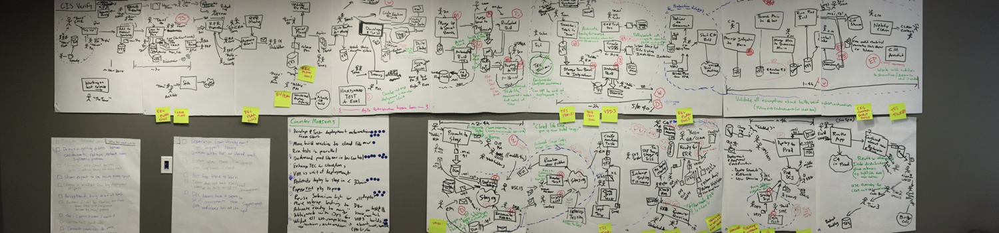
Visualize the work
Agile
Development
Release Plan
Everything else done to Deploy….
Notes:
Plus the benefit of a kick ass visual is that, it makes it really obvious to everyone in the room where the problem is.

Slide 14
Numbers work too
Team delivered 160% more features over five sprints after implementing DevOps Improvements/ Automation
Notes:
And sometimes just the numbers tell a story. Ideally you want both pictures and numbers – but apply both tools based on the audience

Slide 15

Truth… it depends on perspective
Notes:
I think the other power of visualization is that in abstract things, there isn’t always true and not true, there is truth, and then different perspectives on truth.
The more you make the abstract visual through things like charts, numbers, visualization maps, kanban boards - the more you help get to truth - and not just perspective of truth
And this is the part you are not going to get from John Kottter – the essence of a DevOps transfomration is this – creating that “vision for change’ neemds to be “creating shared vision” and creating systems thinking. Words are not enough.

Slide 16
Step 3:
Make Change Happen

Slide 17
How to Make Change Happen
Build (Find) a good team
Let them figure out how to mange change
Go slay organizational dragons
Manage your change program intentionally

Slide 18
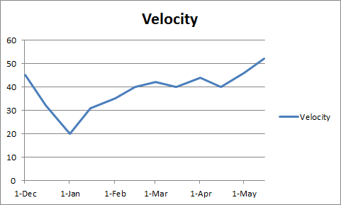
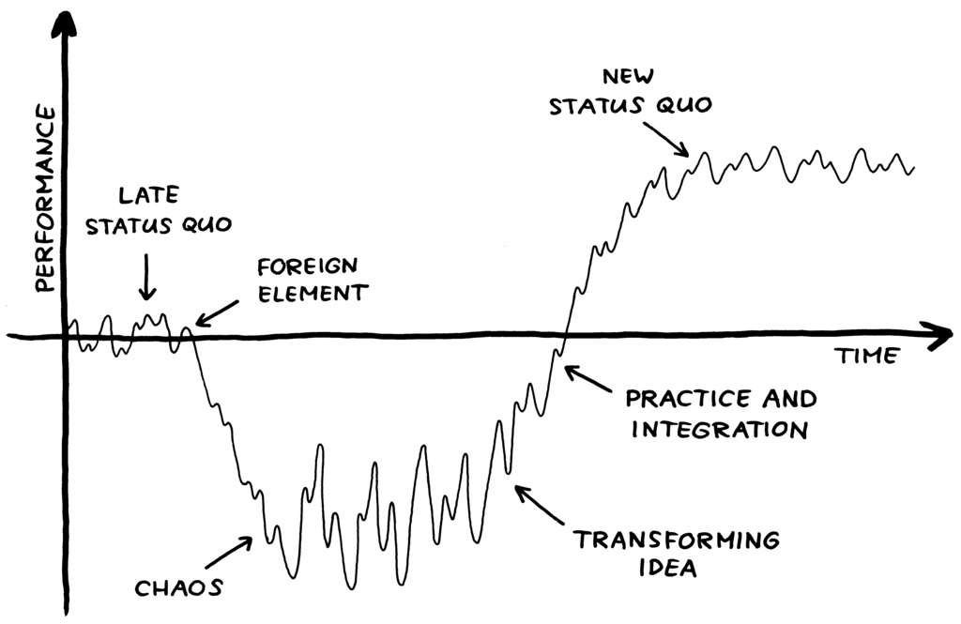
Allow the J-Curve to Happen
Notes:
A practice I have seen in the federal government is creating a contract that incentivizes or requires the contractor to meet or exceed a certain velocity as part of a SLA for payment. On one hand, sounds like a good idea.
On the downside, what I see happen is they are incentivized to go fast at all costs, even if what they build is fragile and unsustainable….
and the incentive to innovate is low - because you are contractually not allowed to experience the J-Curve that comes with innovation
On the left there is a picture of a very famous theoury – you may have heard – the Virginia Satir Curve
On the right is an actual chart of the velocity of one of our Devops Pilot teams velocity while taking on the new practices.
Real change always starts with first, sucking a little.

Slide 19
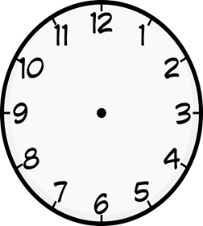

Where you will spend your time…
Automating System
Slaying Organizational Dragons
< 20 hours
4 months
Notes:
And, when you plan to spend your time on making the change happen
Be real about where you will spend your time.
Same team I just showed you – we implemented the automation in under 20 hours of time, total effort.
Getting mother-may-I permission to use the automation, getting partner organizations on board
Opening the change request for the firewall
Getting the process and QA group to approve replacing a prior process
Getting the program manager to agree to push this
Getting the Operations team’s boss permission to let his team run the automation scripts…
That took on or about 4 months of effort, a good 20% of my lead’s time just chasing that silliness down.
Its about tools, but its not only about tools.

Slide 20
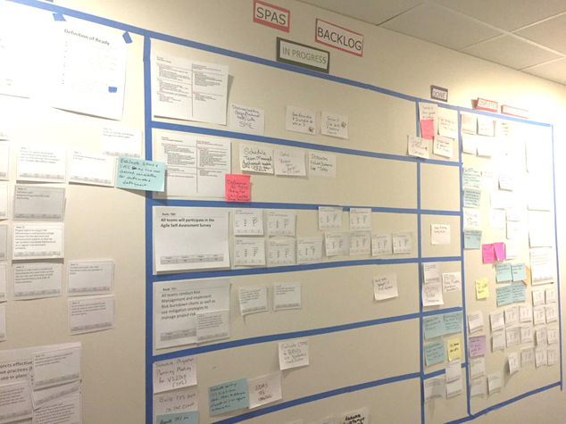
Change Improvement Board
Use Lean to go Lean -
Limit Work in Progress
Notes:
Sometime you have to take things into your own hands
I think if you want to change, you have to be deliberate about it. Borrowing a page from Succeeding with Agile, by Mike Cohn, there is this great formula for
using agile to manage an agile transformation
but basically, its the idea of a prioritized change backlog
So on my program now we have one of these
its outside my office. We meet daily to talk about it
We meet every two weeks with the larger program to talk about priorities and get inputs
and for everything on the left, we have an Improvement Kata - which is a quick chart with our goal, our current and to be state, and the measurements around that
then we have a swimlane of all the little things we are working on to improve that thing.
And it forces us to prioritize and get improvements done before moving to the next area.

Slide 21
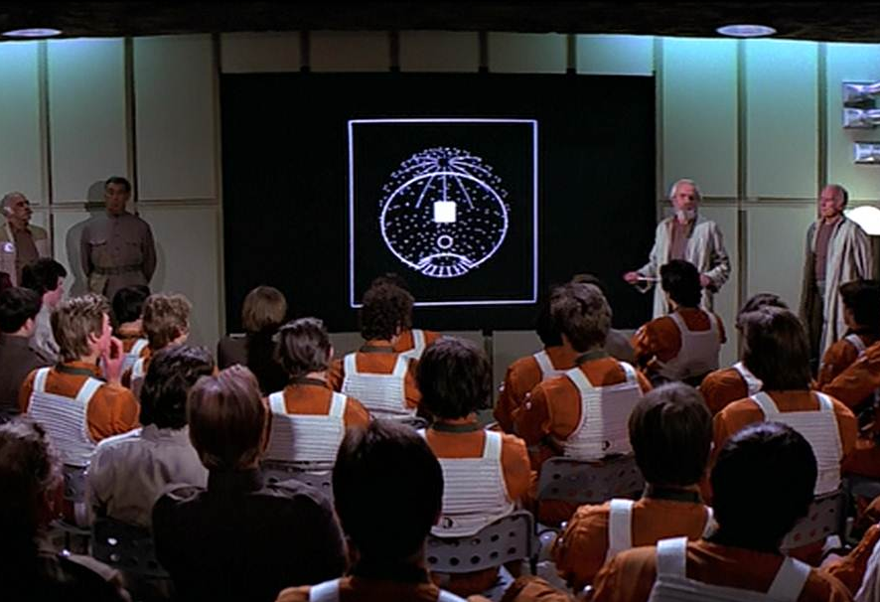
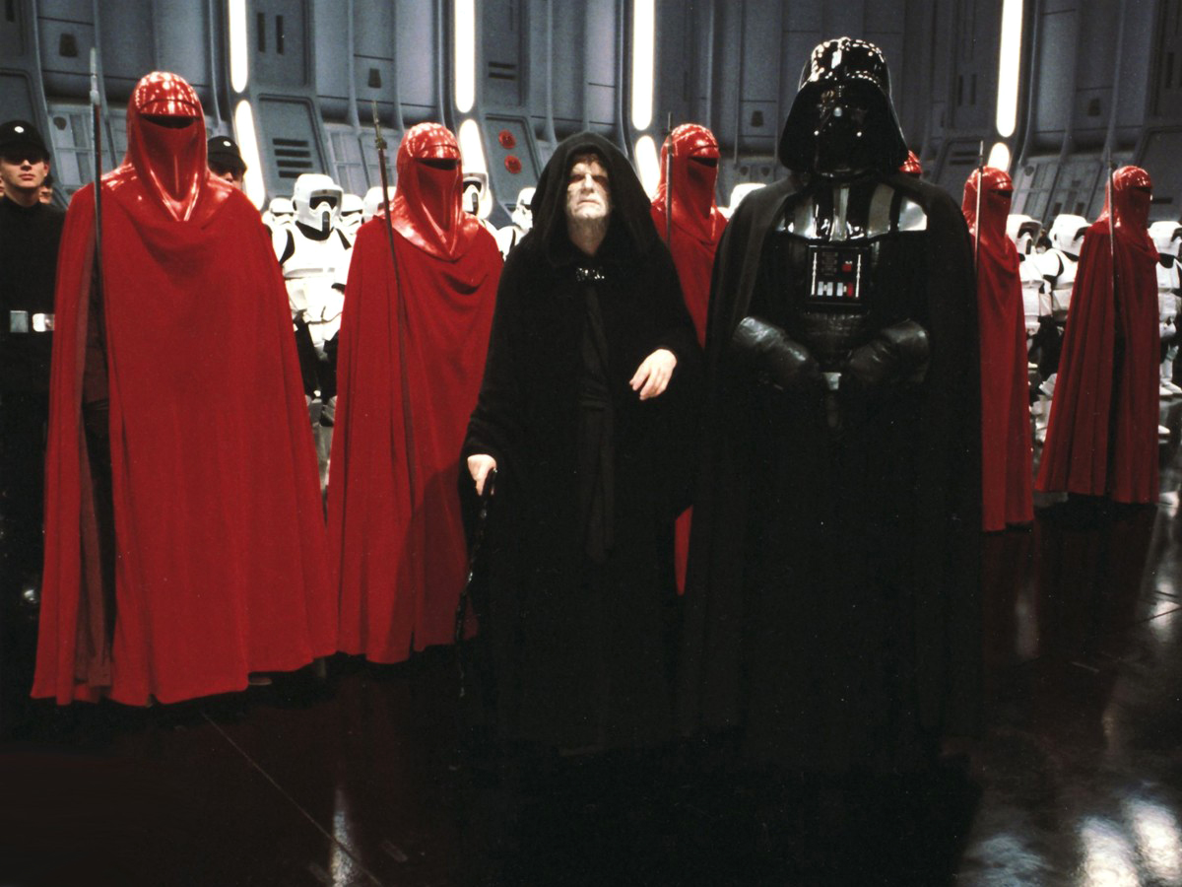
Do not confuse the Rebel Alliance with the Imperial Senate!
Notes:
So this is my second go round on the improvement backlog and the first time I failed -
I learned a very valuable lesson.
Remember - those in power want to destroy you and your success. The people who will help you transform are not determined by job title, pay or rank. Don’t feel forced to invite known enemies to the table for your improvement board.
Brief those people as needed, or weekly or monthly or whatever makes sense.
Get it done with your rebel alliance.
They are the smart people who will get it done and apply jedi mind tricks

Slide 22

Improvements to waste can be dramatic!
12 Hours
12 Minutes, 30 seconds
*Actual improvement from automating deployments to staging
Notes:
And when you finish all this - awesome stiff happens! Yippee!!
This was what one of my teams did with their automation.

Slide 23

Catalyst Change Cycle
Disrupt Status Quo
Create desire to change
Change Team
Find the Change Team
Change the Burocracy
Measure Improvement
Measure Baseline
Visualize System of Work
Identify Waste
Improvement
Backlog

Slide 24
5 Take Aways
Build the “Rebel Alliance” and change program
Want to Change
Visualize the Change
Make the Change
Repeat! Repeat! Repeat!

Slide 25
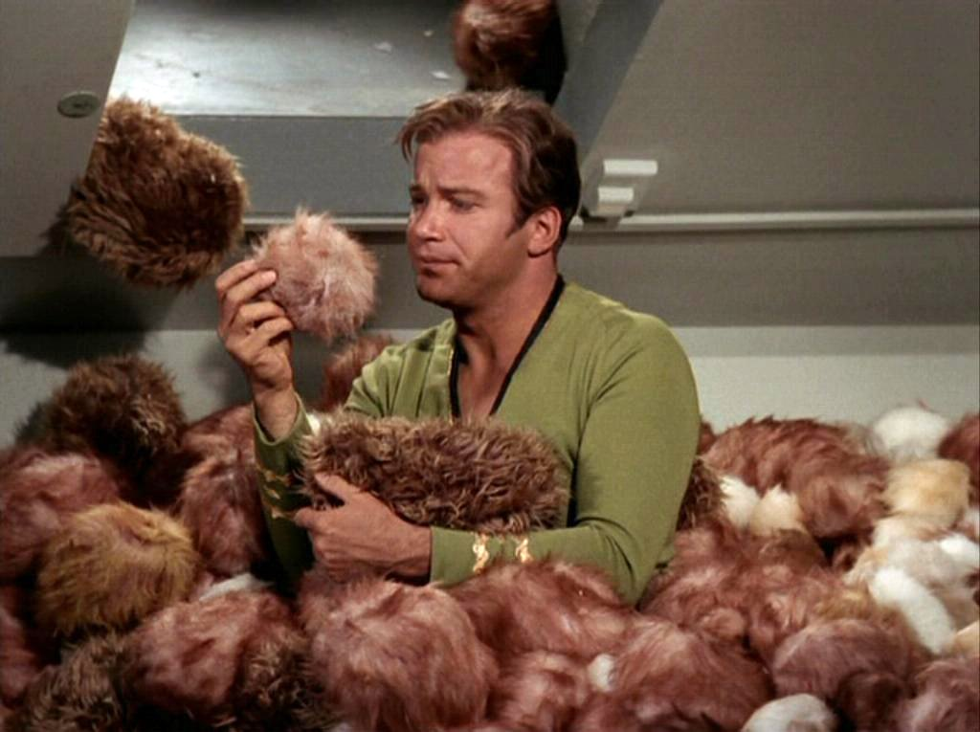
What I still don’t know how to do
Create and Scale DevOps “Change Agents” fast enough………

Slide 27
Backup

Slide 28
Numbers work too
Trends show a decrease of two months to implement a release after transformation

